Slide 1
Object detection using cv-sdk

Slide 2
Smart video Workshop Overview
Introduction
Basic End to End Object Detection Example: Intro to Inference Engine + Model Optimizer
CVSDK 101
Introduction to Intel® technologies for deep learning inference
Hardware acceleration techniques
H/W Acceleration
3. HW Acceleration with CPU, Integrated GPU, Intel® Movidius™ NCS, FPGA
Each Module contains a hands-on lab exercise that will introduce to various Intel technologies to accelerate computer vision application with hardware heterogeneity.
4. Optimization Tools and Techniques
Optimization
5. Advanced Video Analytics
Application

Slide 3
Inference Engine

Slide 4

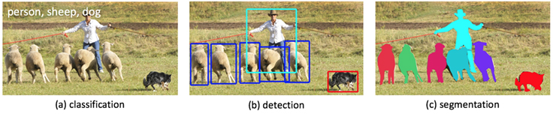
Inference on an edge system
There are many types of deep learning networks, choose the one you need
The complexity of the problem (data set) will dictate the network structure
The more complex the problem, the more ‘features’ will be required, the deeper the network.

Slide 5
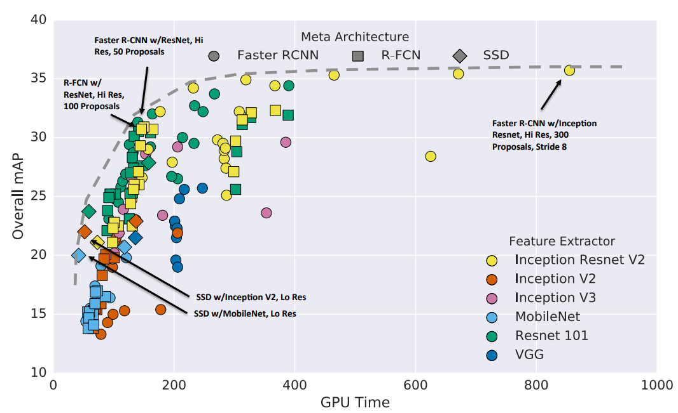
Inference on an edge system
Major network properties are
Accuracy level and number of objects to be detected/classified
Usually measured by Accuracy % or mAP – mean average precision
Memory footprint required to hold the weights
Input image size
Some networks work on the full image, some on only smaller region of interest
Accuracy vs time for different networks (Extractors)
multiple points for same extractor represent different input sizes, stride, etc

Slide 6
Inference on an edge system
Major network properties (continued)
Memory footprint required to hold the weights
Compute footprint
Usually measure by MAC –Multiply Accumulate operations
Network | Common Memory Footprint (MB) | Common Compute Footprint (GMAC) | Common Input Size
Yolo Tiny v1 | 51.67 | 1.61 | 448x448
SSD500 | 51.88 | 98.6 | 512x512
Faster-RCNN(VGG16) | 261.5 | 188.6 | 1000x600
Resnet-50 | 48.71 | 3.9 | 224x224
Alexnet | 116.26 | 0.73 | 227x227
GoogleNet | 13.33 | 1.58 | 224x224
Squeezenet | 2.36 | 0.39 | 227x227
Pay attention to the differences in Memory and Compute requirements per network
and match them to your target device.
Accuracy vs time for different networks (Extractors)
multiple points for same extractor represent different input sizes, stride, etc

Slide 7
Inference on an edge system
Inference implementation parameters
Throughput
System requirements will dictate the minimal Frames per second (FPS) or Inferences per second (IPS)
Select the lowest frame rate that satisfies the requirements.
Inference is a highly compute intensive task (e.g. VGG16 ~31 GOP/Image)
Latency
Time from data being available for analysis to the time a result is available
Bottleneck may include network latency, buffer copies, etc.
Batching will cause the latency to increase, but throughput and efficiency will also increased
Memory
Size of model. Size of images being processed.
Consider your system memory capacity, memory bandwidth etc.
Efficiency
Inferences/sec/watt = (Inferences/sec) / (System Power (W))
An important criteria for HW selection.
A real system has power and price limitations

Slide 8
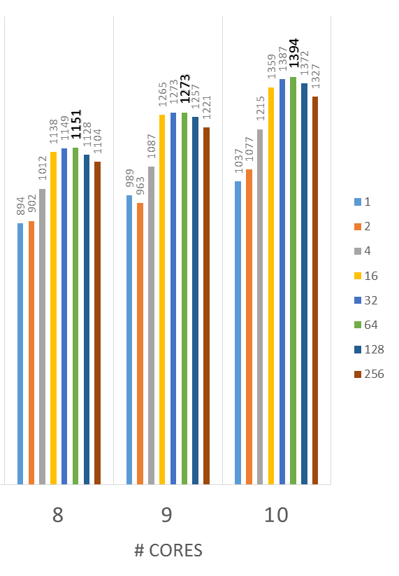
Inference on an edge system
Network | IP | Batch | Precision | Inf/sec | WL Power (W) | Latency (mS) | Efficiency (Inf/W)
Alexnet | A10 1150 | 1 | FP11 | 101 | 38 | 9.91 | 2.66
Alexnet | A10 1150 | 2 | FP11 | 187 | 38 | 10.70 | 4.92
Alexnet | A10 1150 | 4 | FP11 | 329 | 38 | 12.16 | 8.66
Alexnet | A10 1150 | 8 | FP11 | 521 | 38 | 15.36 | 13.71
Alexnet | A10 1150 | 96 | FP16 | 1000 | 38 | 96.00 | 26.32
Tradeoffs in this example.
Inference/Sec and Efficiency increases with larger batch size,
but also latency ..
But batch size is not a silver bullet
Batch 32 is probably the sweet-point for this specific device
Higher batches limited by available memory size and bandwidth
FPS (Frames/Sec)
batch
size

Slide 9
Inference on an edge system
Weights format
Most networks today are trained with FP32 format
Model optimizer can change the weights format to FP16 or others
A more compact format can help with memory bandwidth and compute, but it really depends on the devices (CPU/GPU/FPGA/etc) architecture
This might vary with the topology, but in general we recommend
FP32 for CPU
FP16 for GPU and other device types

Slide 10

Inference Engine
Application
Inference Engine
FPGA Plugin
MYRIAD Plugin
MKLDNN Plugin
clDNN Plugin
Arria
Movidius™ Myriad™ 2
CPU
GEN

Slide 11
Inference Engine Architecture

Slide 12
Workflow
Initialization
Initialize
Load model and weights
Set batch size (if needed)
Load Inference Plugin (CPU, GPU, FPGA)
Load network to plugin
Allocate input, output buffers
Main loop
Fill input buffer with data
Run inference
Interpret output results
Fill Input
Infer
Interpret Output

Slide 13
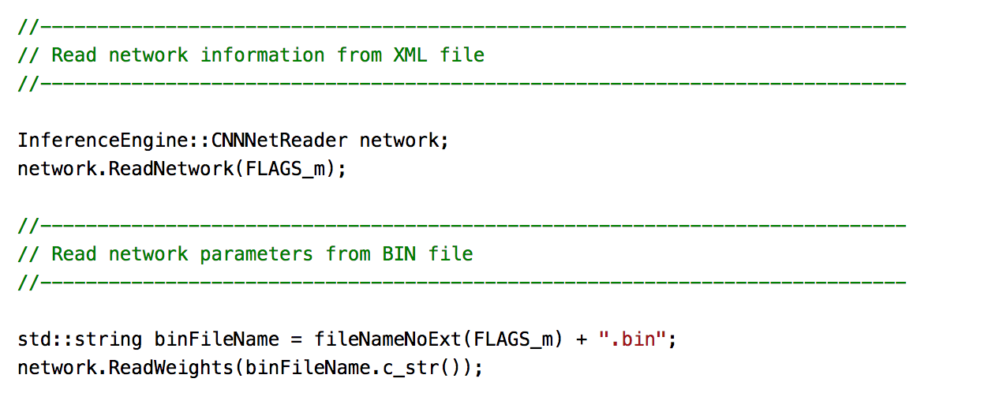
Load model

Slide 14
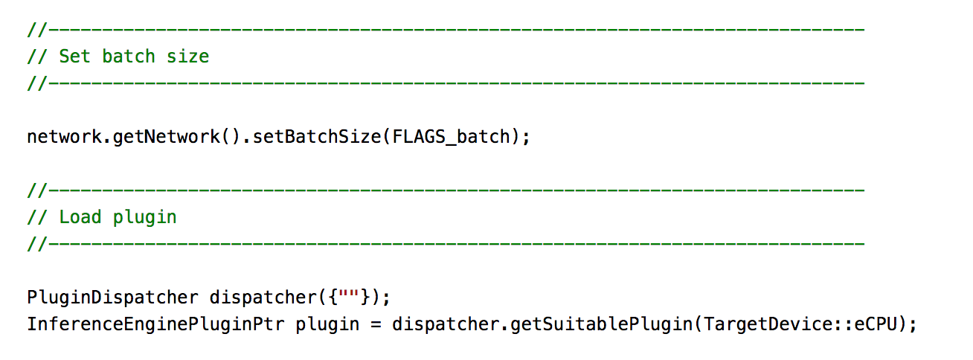
Load plugin

Slide 15
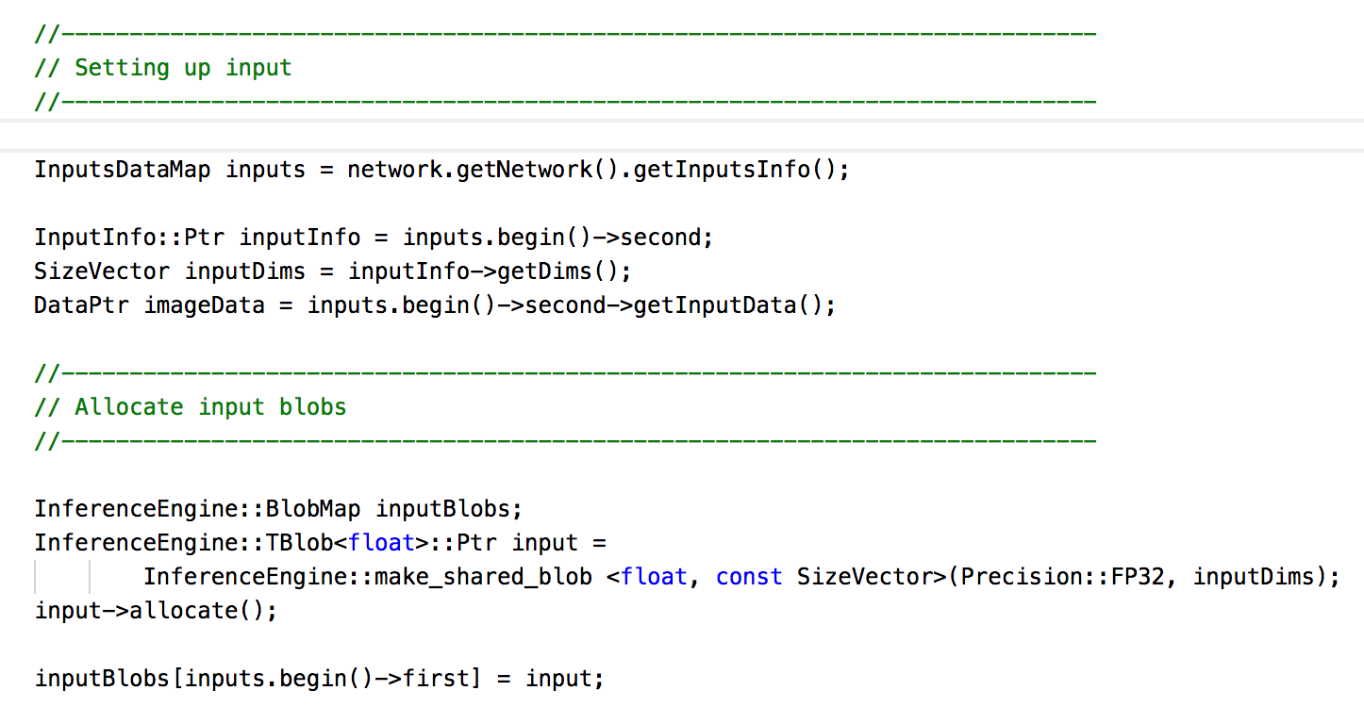
Input

Slide 16
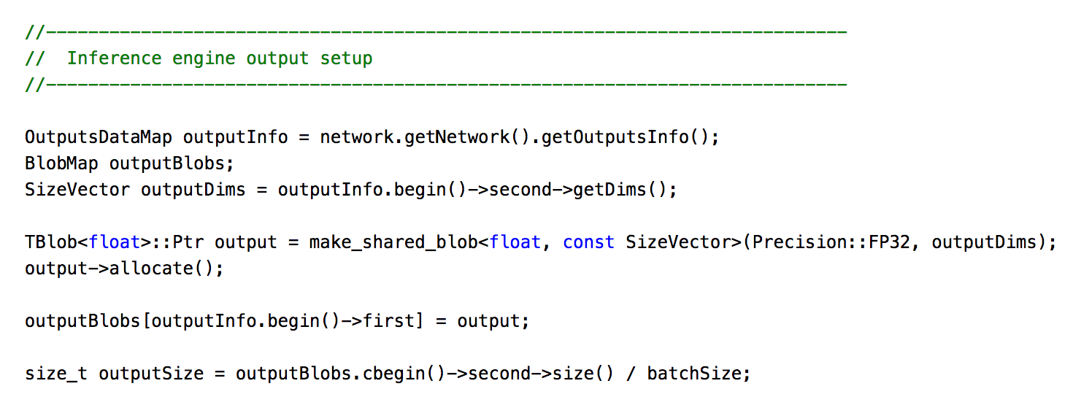
Output

Slide 17
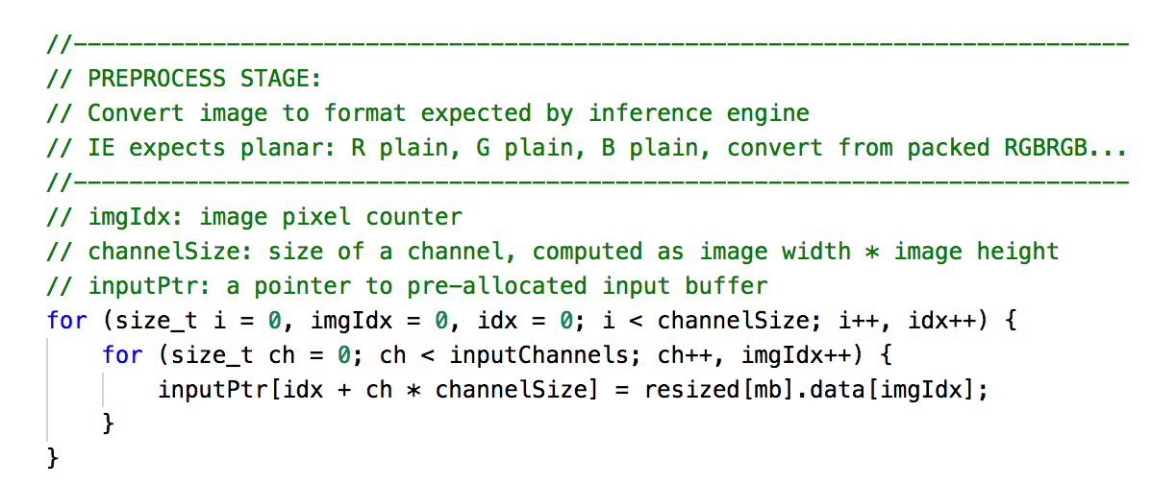
Prepare input data

Slide 18
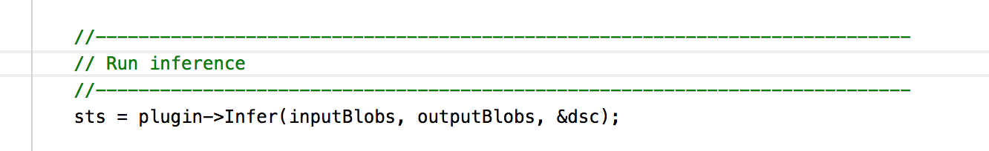
Infer

Slide 19
Pre-processing
Most of image formats are interleaved formats (RGB, BGR, BGRA, etc.)
Inference Engine expects input to be in RGB planar format:
R-plain, G-plain, B-plan
Intervealed
Planar

Slide 20
Pre-processing
Developer responsible to re-order input image data to planar format.
Some models requires to normalize input values by multiplying each value with scale factor
Some model requires to subtract mean values.
Two ways to apply normalization and mean:
Do normalization and mean subtraction while pre-processing image data
Convert model byModel Optimizer with providing additional arguments:
--mean_values (104.006, 116.66, 122.67)
-- scale_values (0.07, 0.075, 0.084)

Slide 21
Pre-processing
Developer responsible to parse inference output.
Many output formats. Some examples:
Simple classification (alexnet): an array of float confidence scores, # of elements=# of classes in the model
SSD: many “boxes” with a confidence score, label #, xmin,ymin, xmax,ymax
Unless the model is well documented it may not be immediately obvious what the output pattern is…

Slide 22
Model optimizer
Coverts models to IR format

Slide 23
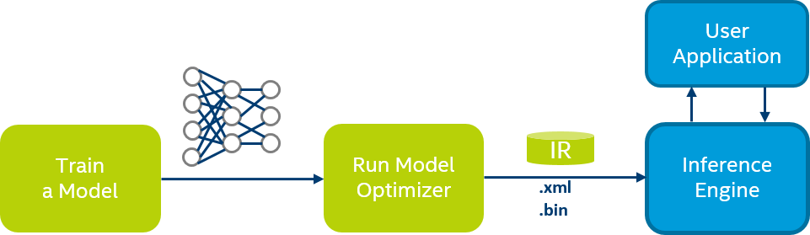
Model Optimizer
Convert models from various frameworks (Caffe, TensorFlow, MXNet)
Converts to a unified Model (IR, later n-graph)
Optimizes topologies (Node merging, batch normalization elimination, performing horizontal fusion)
Folds constants paths in graph

Slide 24
Canonical Developer workflow
This part of the process could be a loop…
1
2
Trained Model
4
Develop and Train a Model
Run Model-Optimizer
Deploy in App with IE
3
IE test harness
Validate perf + accuracy
Design and Train your network
Convert & Optimize your network
Test and Validate on actual hardware/environment , Get Feedback:
is accuracy good? performance good? What is the best batch?
Deploy using your chosen IR model.

Slide 25
Model Optimizer
Model Optimizer is a cross platform tool written in Python
Python 3.5 or higher
Pip packages:
Mxnet
Tensorflow
Protobuff
Etc. Check list of required packages in requirements.txt
Example usage
python mo.py --framework tf --input_model /models/optimized.pb

Slide 26
Model Optimizer
Caffe
Tensorflow
XML
Trained Model
Model Optimizer
MXnet
BIN
Keras

Slide 27
Model Optimizer High-level Architecture
Frontend
Middle-end
Backend
Parse framework model to create internal graph representation
Frameworks
Caffe
Tensorflow
MXNet
Keras (experimental)
Applies optimization to internal graph
Batch Normalization to Scale Shift
Fold Scale Shift with Convolution
Drop unused layers (Dropout)
BGR input conversion (RGB is expected from IE)
FP16 quantization
XML file storing information about layers and connections (edges)
BIN file storing model parameters (like weights and biases for Convolutions)

Slide 28
Optimizations: Batch Normalization
Original Model
Converted Model
Inference
Convolution
Convolution
Batch Normalization
Convolution
ReLU
ReLU
Pooling
Pooling
Pooling

Slide 29
Optimizations: Convolution + Eltwise
Convolution
Convolution
Convolution
Eltwise
Convolution + Sum + ReLU
ReLU
ResNet-152 has 50 of Eltwise layers

Slide 30
Performance benefits based on ResNet-152
Model Optimizer (offline)
Merge Convolution and Batch Normalization by recalculating Convolution weights and remove BN from resulted topology
Inference Engine (runtime)
Fuse graph and use corresponding kernels to speed up inference
Runtime | Fused kernels | Speedup*
IntelCaffe + MKL | None yet | baseline
Inference Engine | Conv+Relu | 40%
Inference Engine | Conv+Sum+Relu | 51%
* Speedup measured on:
HW | CPU: Intel(R) Core(TM) i7-6700 CPU @ 3.40GHz (1 socket x 4 cores); TDP: 91W
 | GPU: Intel Corporation Sky Lake Integrated Graphics [8086:1912] @ 1.0GHz
OS | Ubuntu 16.04.1 LTS | kernel version: Linux 4.7.10 x86_64

Slide 31
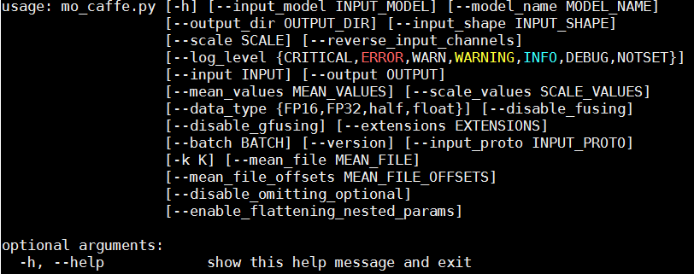
Model Optimizer: Usage
/opt/intel/computer_vision_sdk_2018.0.219/deployment_tools/model_optimizer$ python3 mo_caffe.py --help
Intel Confidential

Slide 32
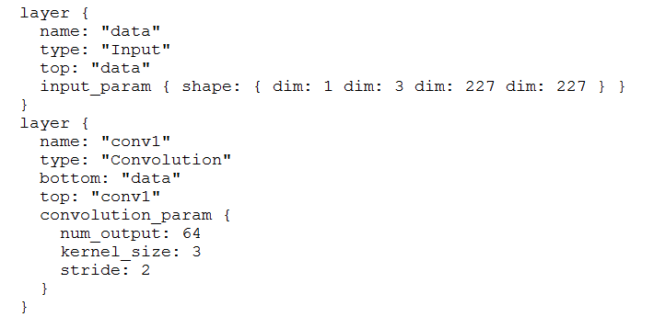
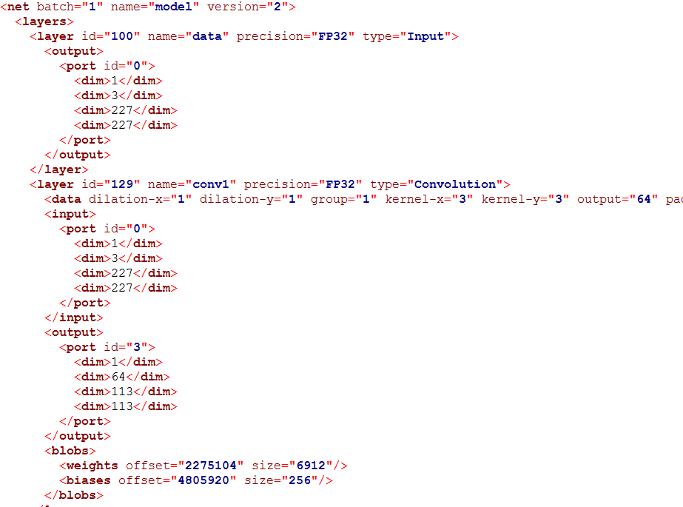
Intermediate Representation (IR)
Squeezenet1.1.caffemodel
Squeezenet1.1.bin
Squeezenet1.1.prototxt
Squeezenet1.1.xml
Intel Confidential

Slide 33
Hardware heterogenity
CPU/gpu/fpga/movidius neural compute stick

Slide 34














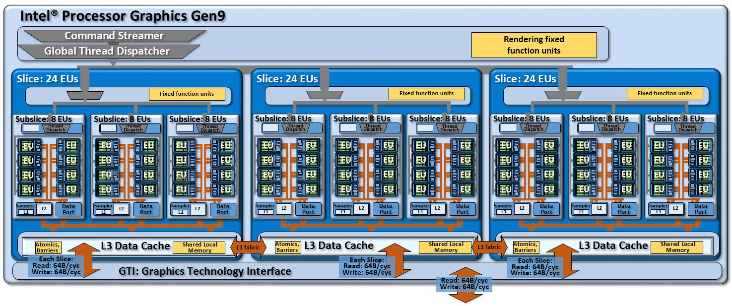
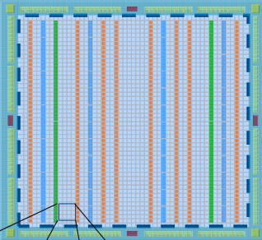



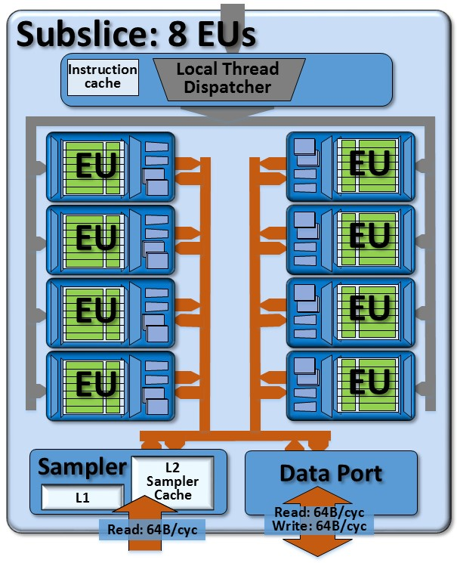
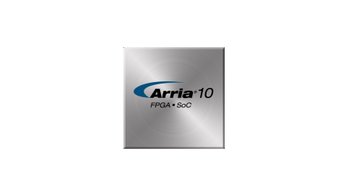
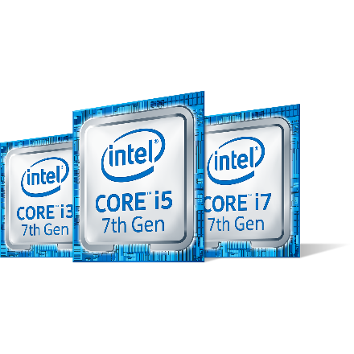


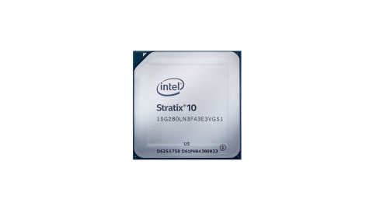
Industry trend: the Heterogeneous Era
CPU
Superscalar (SIMD)=1990s
Yesterday: apps run on single HW type
Today: apps are faster with multiple blocks
INT
INT
INT
FP
FP
CPU0
CPU1
Multicore = 2000s
CPU2
CPU3
Heterogeneous Era (today)
CPU Only
CPU+Gen Graphics
PSG FPGA
Machine Learning
And more!
Movidius
Notes:
Demo: encode is faster w/HW acceleration
Machine learning is faster with Gen and FPGAs as well as specialized HW
von Neumann architecture (1945)
Superscalar era (1990s)
Instruction level parallelism
Data level parallelism (SIMD)
Multicore era (2000s)
Homogeneous cores
Thread level parallelism
Diminishing returns
(Then things get interesting!)
5. Heterogeneous era (today)
Multiple engines – use best match for the job
OpenCL
Highly used, large, well defined operations candidates for FF: Codecs, img processing
Great performance/power advantages
Quick demo: show HW acceleration vs. CPU here to illustrate that the perf improvement is disruptive and hard to ignore. CPU is getting incremental perf improvements and power reductions.

Slide 35
Couple of Hetero dichotomies
Data vs. Task parallelism
Data parallelism between devices is usually explicit and extremely error-prone (just like in OpenCL)
Inference Engine Hetero support is inherently task-oriented (node-level)
Dynamic vs Static
User-defined work split vs. adaptive schemes (like load-balancing)
For both there is a question on the granularity (communications costs, next)
“Heterogeneity” is basically “Fallback“

Slide 36
Applying device affinities to layers: Automatically, using the fallback policy, 1
$ object_detection_sample_ssd -d HETERO:CPU,GPU -l lib/libicv_extension.so -m ssd.xml -i snake.bmp
All IE samples support that
You can load CPU and GPU extensions as usual (“-l” and “-c”)
The “priorities” just defines a greedy behavior
Keeps all layers that can be executed on the device (FPGA)
Carefully respecting the topological and other limitations
Then follows priorities when searching ( e.g. CPU)

Slide 37
Applying device affinities to layers: Automatically, using the fallback policy , 2
HeteroPluginPtr plugin(make_plugin_name("HeteroPlugin"));
CNNNetReader reader;
reader.ReadNetwork(“Model.xml”);
reader.ReadWeights(“Model.bin”);
CNNNetwork network = reader.getNetwork();
plugin->SetConfig({ { "TARGET_FALLBACK", “FPGA,CPU"} }, &response);
plugin->LoadNetwork(exeNetwork, network,{}, &response);

Slide 38
Intel movidius neural compute stick

Slide 39
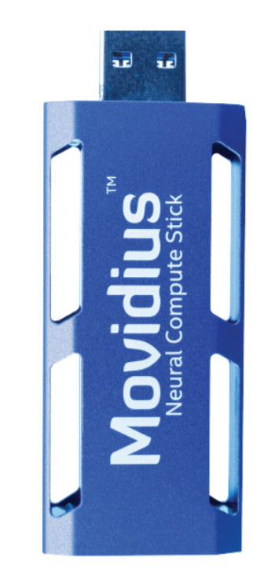
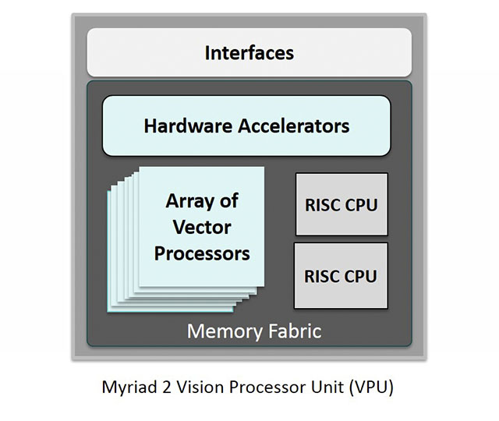
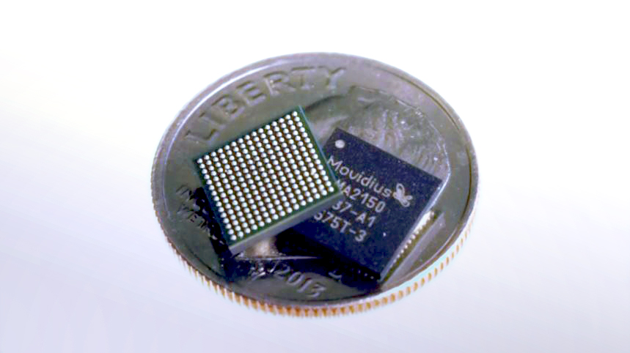
Intel® Movidius™ Myriad™ 2 Hardware

Slide 40
Hands on example
Car detection

Slide 41
SSD_GoogleNetV2_caffe/SSD_GoogleNetV2_Deploy.prototxt
name: "SSD_300x300"
input: "data"
input_shape {
dim: 1
dim: 3
dim: 300
dim: 300
}
layer {
bottom: "data"
top: "conv1/7x7_s2"
name: "conv1/7x7_s2"
type: "Convolution"
convolution_param { num_output: 64 pad: 3 }
}
layer {
bottom: "conv1/7x7_s2"
name: "conv1/7x7_s2/bn"
top: "conv1/7x7_s2/bn"
type: "BatchNorm"
}
Define input “data” dimensions
300x300, RGB
300
300
3
“Data”

Slide 42
SSD_GoogleNetV2_caffe/SSD_GoogleNetV2_Deploy.prototxt
name: "SSD_300x300"
input: "data"
input_shape {
dim: 1
dim: 3
dim: 300
dim: 300
}
layer {
bottom: "data"
top: "conv1/7x7_s2"
name: "conv1/7x7_s2"
type: "Convolution"
convolution_param { num_output: 64 pad: 3 }
}
layer {
bottom: "conv1/7x7_s2"
name: "conv1/7x7_s2/bn"
top: "conv1/7x7_s2/bn"
type: "BatchNorm"
}
First Layer.. A convolution
“conv1/7x7_s2”
“Data”

Slide 43
SSD_GoogleNetV2_caffe/SSD_GoogleNetV2_Deploy.prototxt
name: "SSD_300x300"
input: "data"
input_shape {
dim: 1
dim: 3
dim: 300
dim: 300
}
layer {
bottom: "data"
top: "conv1/7x7_s2"
name: "conv1/7x7_s2"
type: "Convolution"
convolution_param { num_output: 64 pad: 3 }
}
layer {
bottom: "conv1/7x7_s2"
name: "conv1/7x7_s2/bn"
top: "conv1/7x7_s2/bn"
type: "BatchNorm"
}
Second Layer..
Another convolution
“conv1/7x7_s2/bn”
“conv1/7x7_s2”
“Data”
./SSD_GoogleNetV2_caffe/SSD_GoogleNetV2.caffemodel
Is a binary file, holding all the weights and biases.
Notes:
./SSD_GoogleNetV2_caffe/SSD_GoogleNetV2.caffemodel
Read/visualize it here: https://dgschwend.github.io/netscope)

Slide 44
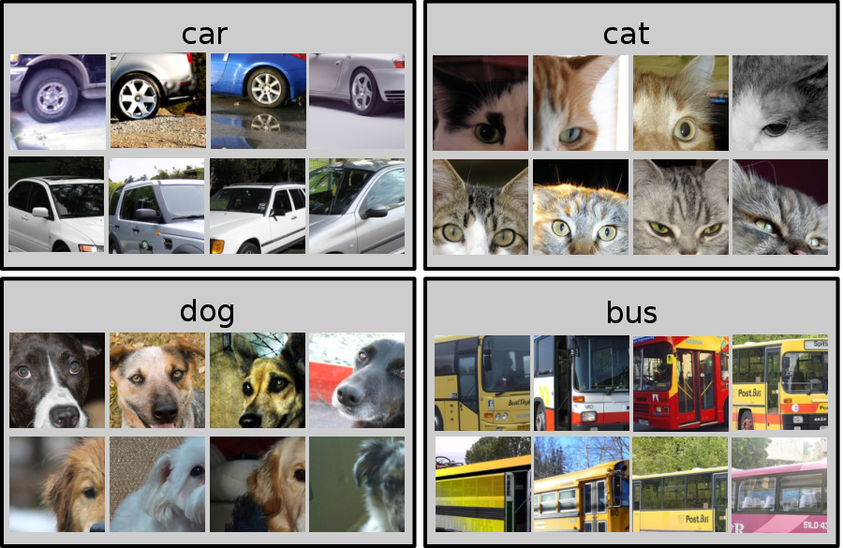
pascal_voc_classes.txt
plane bicycle bird boat bottle bus car cat chair cow table dog horse motorcycle person plant sheep

Slide 45

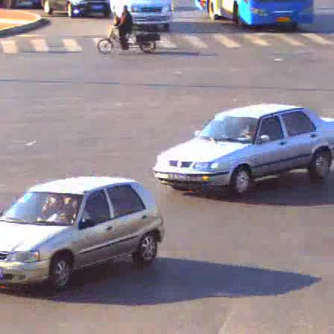

Create IE Instance
Integrate IE (Inference Engine) API to your application
Offline, one time run of the Model-Optimizer
Load IE Plug-in
MKL-DNN plug-in for CPU, Cl-DNN for GPU
Read an IR Model
Set Target Device
Target device could be CPU/GPU/Movidius NCS/FPGA
Load model to plug-in
Allocate Input and Output Blobs
Read data into Input Blob
Decode
Resize
Color conversion..etc
inference

